Slide 1
Malignant Comments Classifier Project
Submitted by – Amruta Shah

Slide 2
Information
The proliferation of social media enables people to express their opinions widely online. However, at the same time, this has resulted in the emergence of conflict and hate, making online environments uninviting for users. Although researchers have found that hate is a problem across multiple platforms, there is a lack of models for online hate detection.
Online hate, described as abusive language, aggression, cyberbullying, hatefulness and many others has been identified as a major threat on online social media platforms. Social media platforms are the most prominent grounds for such toxic behaviour.
Internet comments are bastions of hatred and vitriol. While online anonymity has provided a new outlet for aggression and hate speech, machine learning can be used to fight it. The problem we sought to solve was the tagging of internet comments that are aggressive towards other users. This means that insults to third parties such as celebrities will be tagged as unoffensive, but “u are an idiot” is clearly offensive.

Slide 3
Problem Statement: -
Our goal is to build a prototype of online hate and abuse comment classifier which can used to classify hate and offensive comments so that it can be controlled and restricted from spreading hatred and cyberbullying.
Data Set Description: The data set contains the training set, which has approximately 1,59,000 samples and the test set which contains nearly 1,53,000 samples. All the data samples contain 8 fields which includes ‘Id’, ‘Comments’, ‘Malignant’, ‘Highly malignant’, ‘Rude’, ‘Threat’, ‘Abuse’ and ‘Loathe’. The label can be either 0 or 1, where 0 denotes a NO while 1 denotes a YES. There are various comments which have multiple labels. The first attribute is a unique ID associated with each comment. The data set includes:
Malignant: It is the Label column, which includes values 0 and 1, denoting if the comment is malignant or not. Highly Malignant: It denotes comments that are highly malignant and hurtful. Rude: It denotes comments that are very rude and offensive. Threat: It contains indication of the comments that are giving any threat to someone. Abuse: It is for comments that are abusive in nature. Loathe: It describes the comments which are hateful and loathing in nature. ID: It includes unique Ids associated with each comment text given. Comment text: This column contains the comments extracted from various social media platforms.

Slide 4
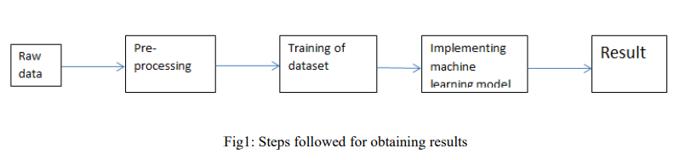
Methodology:-
The steps followed in this work, right from the dataset preparation to obtaining results are represented in Fig.

Slide 5
EDA (Exploratory Data Analysis):-
Import libraries: -
Import pandas as pd # for data manipulation
Import numpy as np # for mathematical calculations
Import seaborn as sns # for data visualization
Import matplotlib.pyplot as plt #for graphical analysis
%matplotlib inline
Import warnings # to ignore any warnings

Slide 6
Technical Requirements:
Mathematical Summary:
Dimensions of Dataset: There are 8 columns and 159571 rows in this dataset.
Null Values: There are no null values in this dataset.
Skewness: Skewness is present in column.
Statistical Summary: Standard deviation is very high in most of the columns.
Special Character are present in both dataset (train and test).
Target Variable: We have 6 target variables which we need to combine and work.
Data Sources and their formats:
Data Sources: We have train and test dataset. We have taken from social media.The proliferation of social media enables people to express their opinions widely online. However, at the same time, this has resulted in the emergence of conflict and hate, making online environments uninviting for users. Although researchers have found that hate is a problem across multiple platforms, there is a lack of models for online hate detection. Online hate, described as abusive language, aggression, cyberbullying, hatefulness and many others has been identified as a major threat on online social media platforms. Social media platforms are the most prominent grounds for such toxic behaviour. There has been a remarkable increase in the cases of cyberbullying and trolls on various social media platforms.
Data Formats: Comment Text & Id columns are object datatype which we need to encode & pre-process.

Slide 7
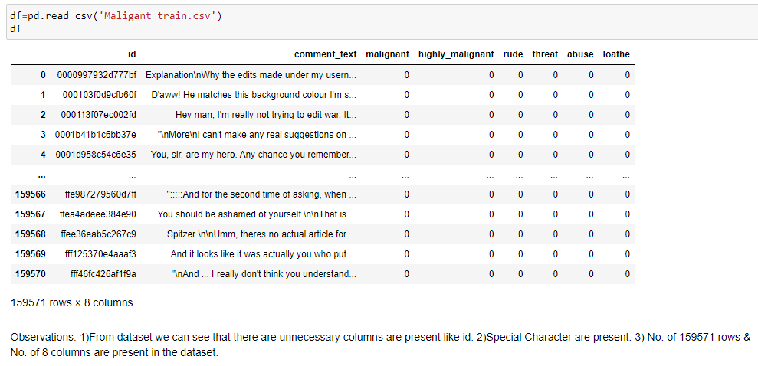
Load Dataset

Slide 8
Observations
Dimensions of Dataset: There are 8 columns and 159571 rows in this dataset(both tarin and test).
Null Values: There are no null values in this dataset.
There is data imbalance in target variable.

Slide 9
Data Visualization
We now have a basic idea about the data. We need to extend that with some visualizations. We are going to look at three types of plots:
Univariate plots to better understand each variable.
Bivariate plots to find relationship between two variables,
Multivariate plots to better understand the relationships between variables.

Slide 10
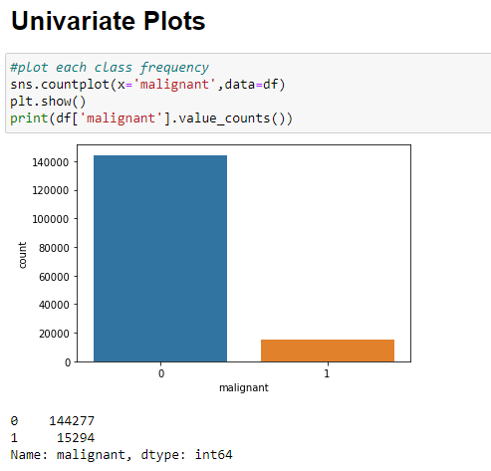
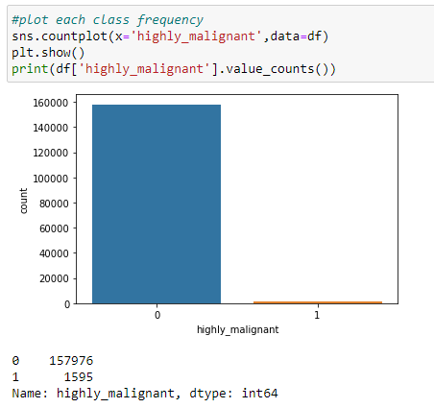
Univariate Plots:-

Slide 11
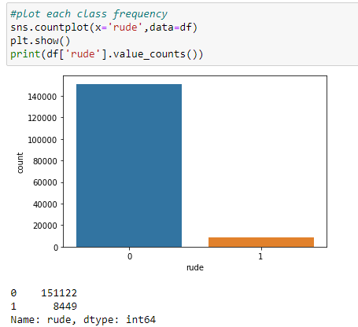

Slide 12
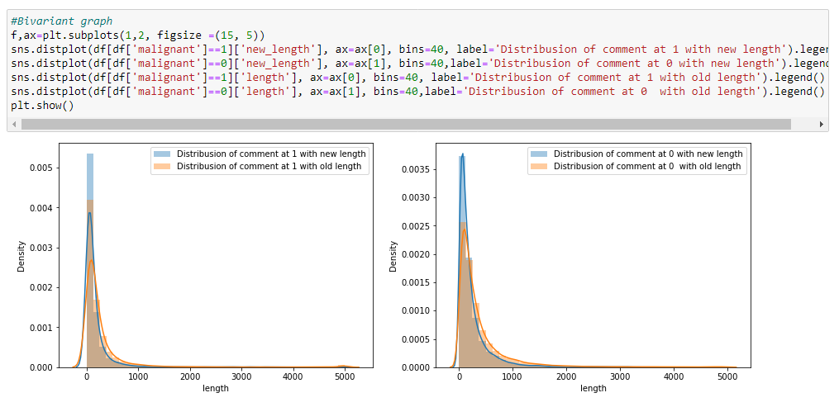
Bivariate Plot

Slide 13
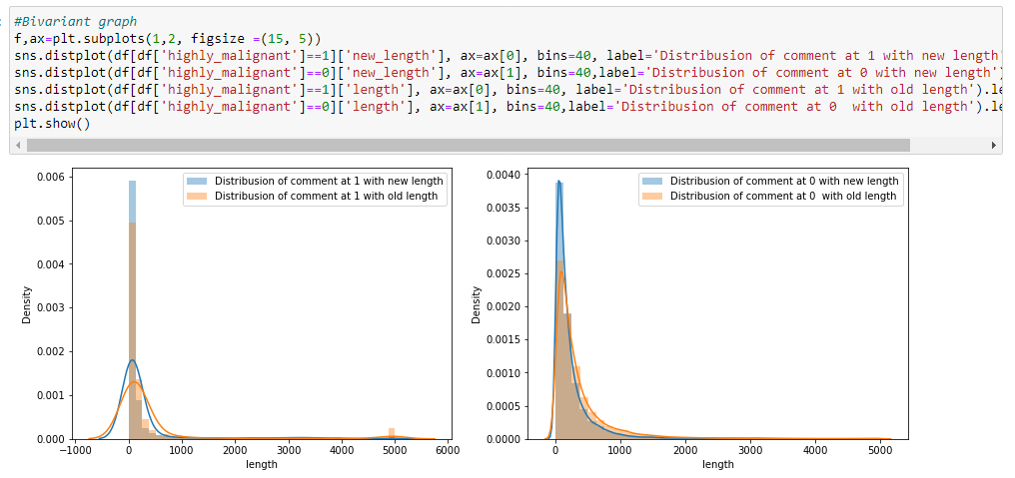

Slide 14
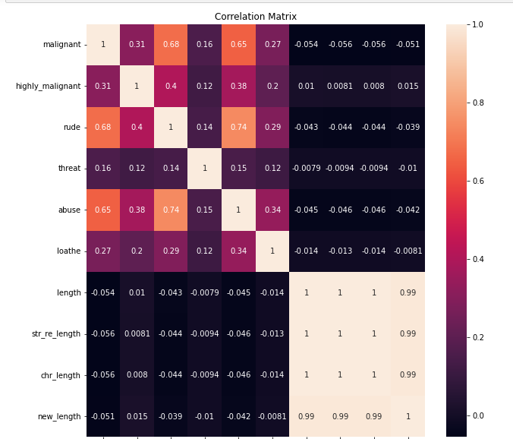
Multivariate Plot

Slide 15
Data Pre-processing:-
First of all, I have check for the duplicates & treated well.
Check for the null values by plotting the heatmap I can not find the same. Moving further I have convert all the data into lower case by using string. lower() method. Further , I have done some NLP text pre-processing like string punctuation, removing special character, removing emoji, remove stop words and meanwhile I have check for the text length and added into dataset. This pre-processing I have done on both train and test data set which is provided.
All steps are shown below.

Slide 16
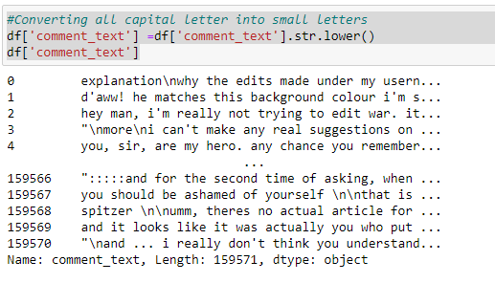
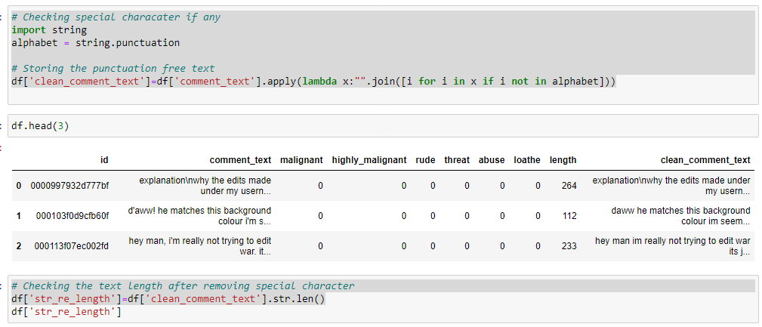
Data Pre-processing:-

Slide 17
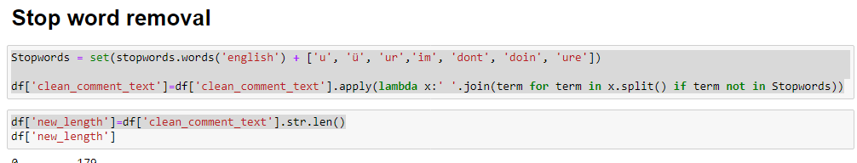
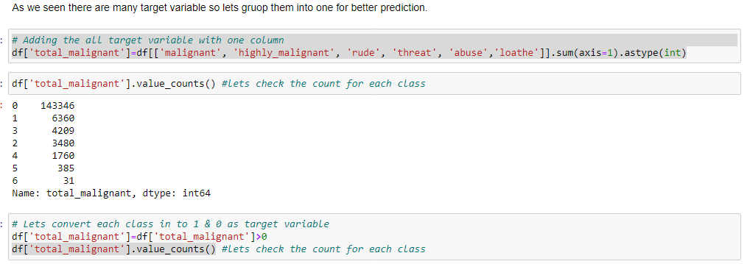
Data Pre-processing:-

Slide 18
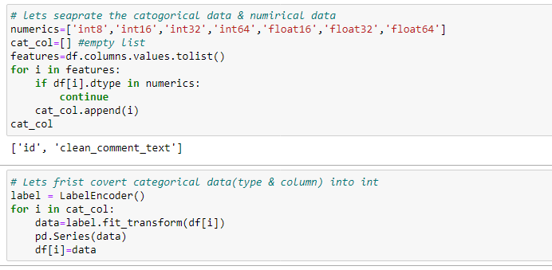
Data Pre-processing:-
As our dataset has objective type data so covert them into int by using Encoding method as shown.

Slide 19
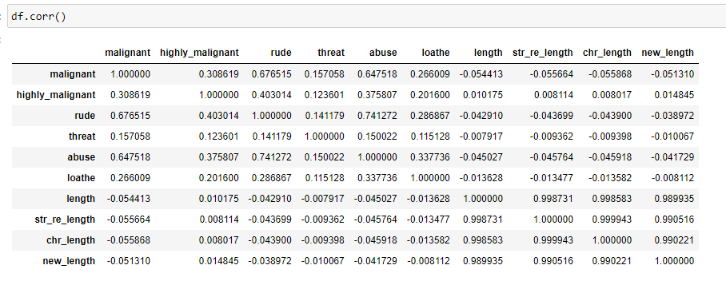
Data Inputs- Logic- Output Relationships
To check the Input output relation, I have plotted the heatmap and data.corr () technique to check the multicollinearity. As shown in below screenshot. And detected no multicollinearity.

Slide 20
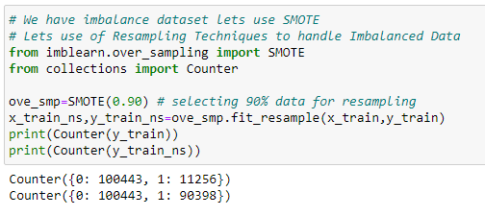
Data Imbalance Handling:

Slide 21
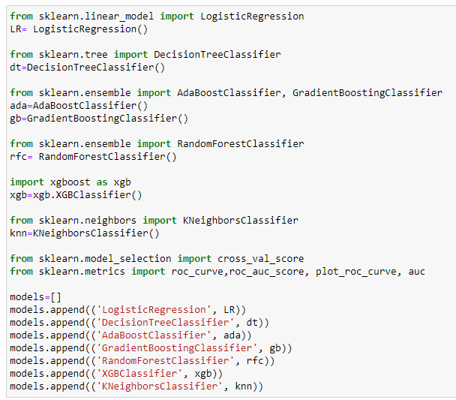
Build the models & select best one

Slide 22
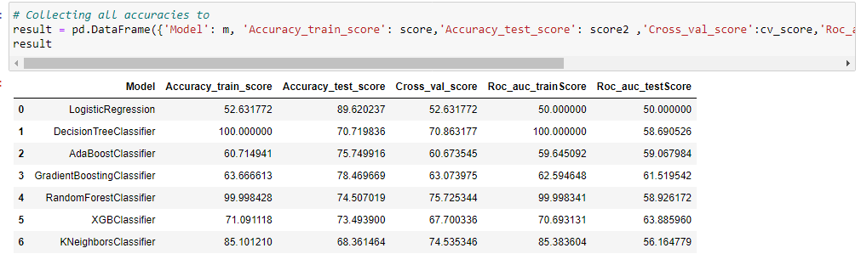
All models accuracy

Slide 23
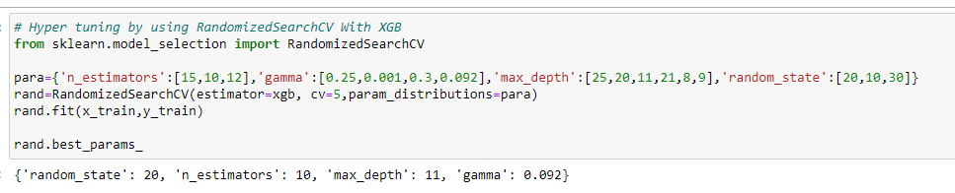
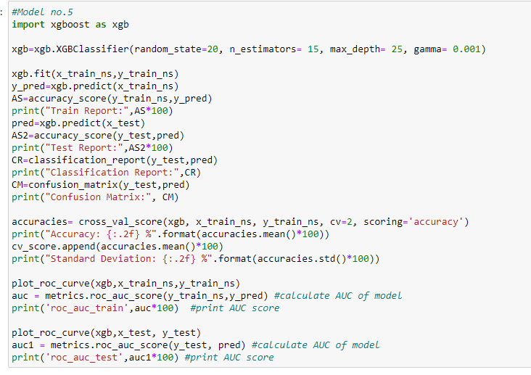
Selected Model

Slide 24
In this project we build the classification model that can predict Malignant based on reviews. The challenge behind predicting models is EDA with NLP. We have gone through how to implement the entire machine learning pipeline, and we have an intuitive understanding of machine learning algorithms. The larger the dataset gets, the more complex each of the mentioned steps gets. Therefore, using this as a base will help while you build your knowledge of machine learning pipelines. Future scope of this project is that we can use to predict the malignant comments to online hate, described as abusive language, aggression, cyberbullying, hatefulness and many others comment’s to avoid mentally leading to depression, mental illness, self-hatred and suicidal thoughts.
Conclusion and Future Scope: -

